Slide 1
Smart car parking system
ENGINEERING TECHNOLOGY AND PRODUCTION
Name : Ranahas Randinu
Grade : 09
School : Nalanda College

Slide 2
Introduction
Parking problem in busy areas
Importance of an automated system
Goals of my parking system (efficiency, security, convenience)

Slide 3
System Overview
Components used:
RFID card reader (for entry)
Servo motors (for gate control)
Lcd display (for display slots)
Web interface (for book slots in online)
Admin and user management system (for control admin web interface)

Slide 4
How It Works
Step 01 : Check lcd display
Step 02 : Check availability
Step 03 : Gate open automatically (servo motor)
Step 04 : Slot status update in database
Step 05 : If you need buy special park

Slide 5
Benefits
Reduces traffic and waiting time
Enhances security
Easy monitoring for admins

Slide 6
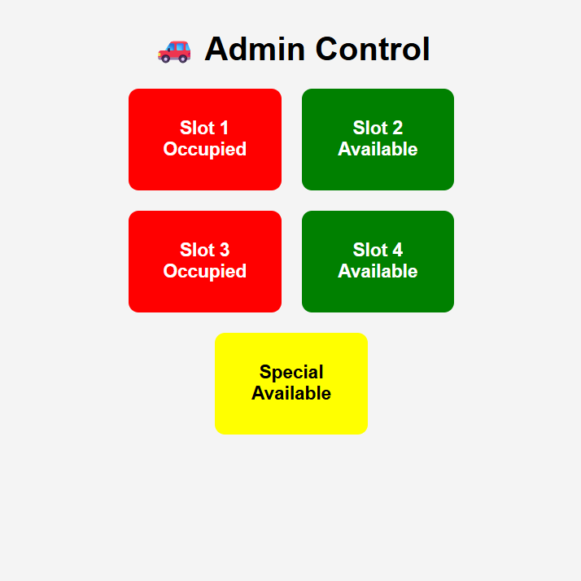
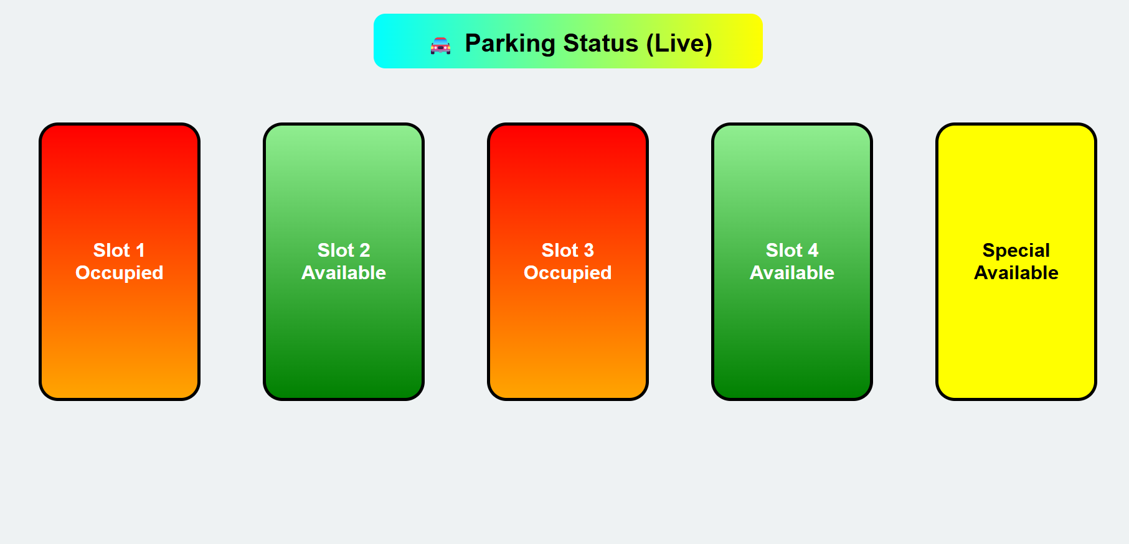
Public page
Admin page

Slide 7
Challenges & Solutions
Challenge: Code is not working
Solution: Re check the code
Challenge: Circuit not working
Solution: Disconnect all parts and re connect

Slide 8
Future Improvements
Mobile app integration
Automated payment system
AI-based system

Slide 9

Thank you
Github link

